Slide 1

Multi-scale Residual Hierarchical Dense Networks for Single Image Super-Resolution
Notes:
Hello, everyone! It’s my honor to introduce our work multi-scale residual and hierarchical dense networks for single image super-resolution here. I will introduce the work from four parts: the background, the motivation and contributions, the network structure, and the experimental results.

Slide 2

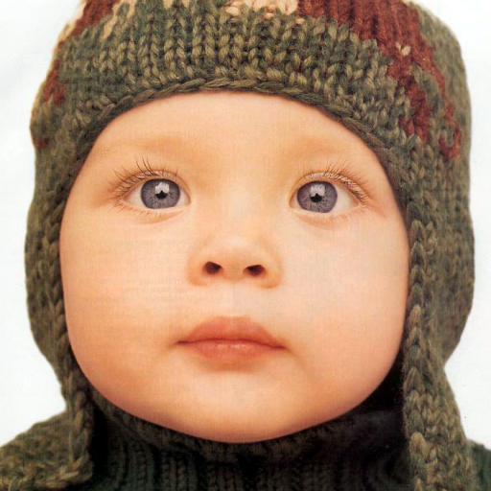

Single Image Super Resolution
Goal: Reconstruct a high quality super-resolved image from a single LR image.
Super resolution
Low resolution
image
High resolution
image
Notes:
The goal of single image super-resolution is to reconstruct a high-resolution (HR) image from its low resolution (LR) version. SISR is widely used in many computer vision fields, such as video surveillance, remote sensing, and image sensing.

Slide 3
Motivation
To make full use of multi-scale and multi-level features from the LR image, we propose a novel multi-scale residual hierarchical dense network.
Notes:
Objects in images may be similar at different scales and information from different scales may gives some clues to help generate high quality super-resolved images. However, most CNN-based methods do not take full use of the multi-level information from different convolutional layers and neglect to use the information from different scales. To make full use of multi-scale and multi-level features from the input LR image, we propose a novel network based on multi-scale structure and residual hierarchical dense connection.

Slide 4
Contributions:
propose a unified framework multi-scale residual hierarchical dense network, which aims at making full use of multi-scale and multi-level features in the LR input image
propose a residual hierarchical dense module to focus on global and local multi-level features
propose a residual multi-scale structure to detect multi-scale features

Slide 5
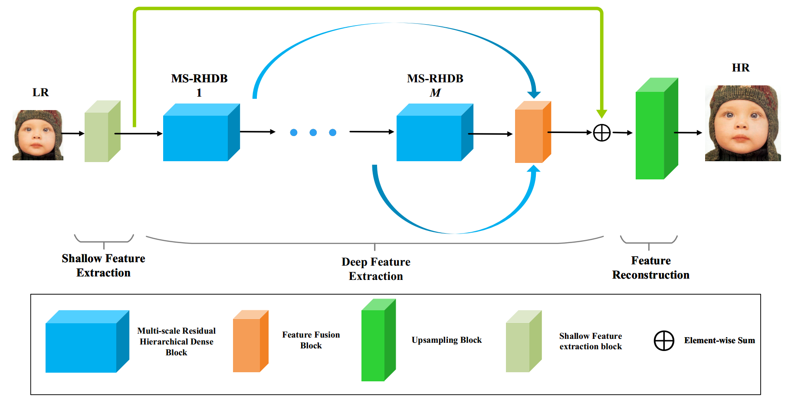
Network architecture
Notes:
Our multi-scale residual hierarchical dense network (MS-RHDN) consists of three main components: shallow feature extraction $F_{SF}$, deep feature extraction $F_{DF}$, and feature reconstruction $F_{REC}$.
We use one convolutional layer to extract shallow features $H_{0}$ from LR image.
Then use M sequential multi-scale residual hierarchical dense blocks (MS-RHDB) and a global fusion layer $F_{GF}$ to extract and fuse multi-scale and multi-level features, respectively. A global skip connection is introduced to make the main parts of the network focus on high-frequency information.
The feature reconstruction module is composed of an upscaling layer $F_{up}$ and a convolutional layer $F_{conv}$. For the upscaling layer, we adopt the sub-pixel convolution.

Slide 6

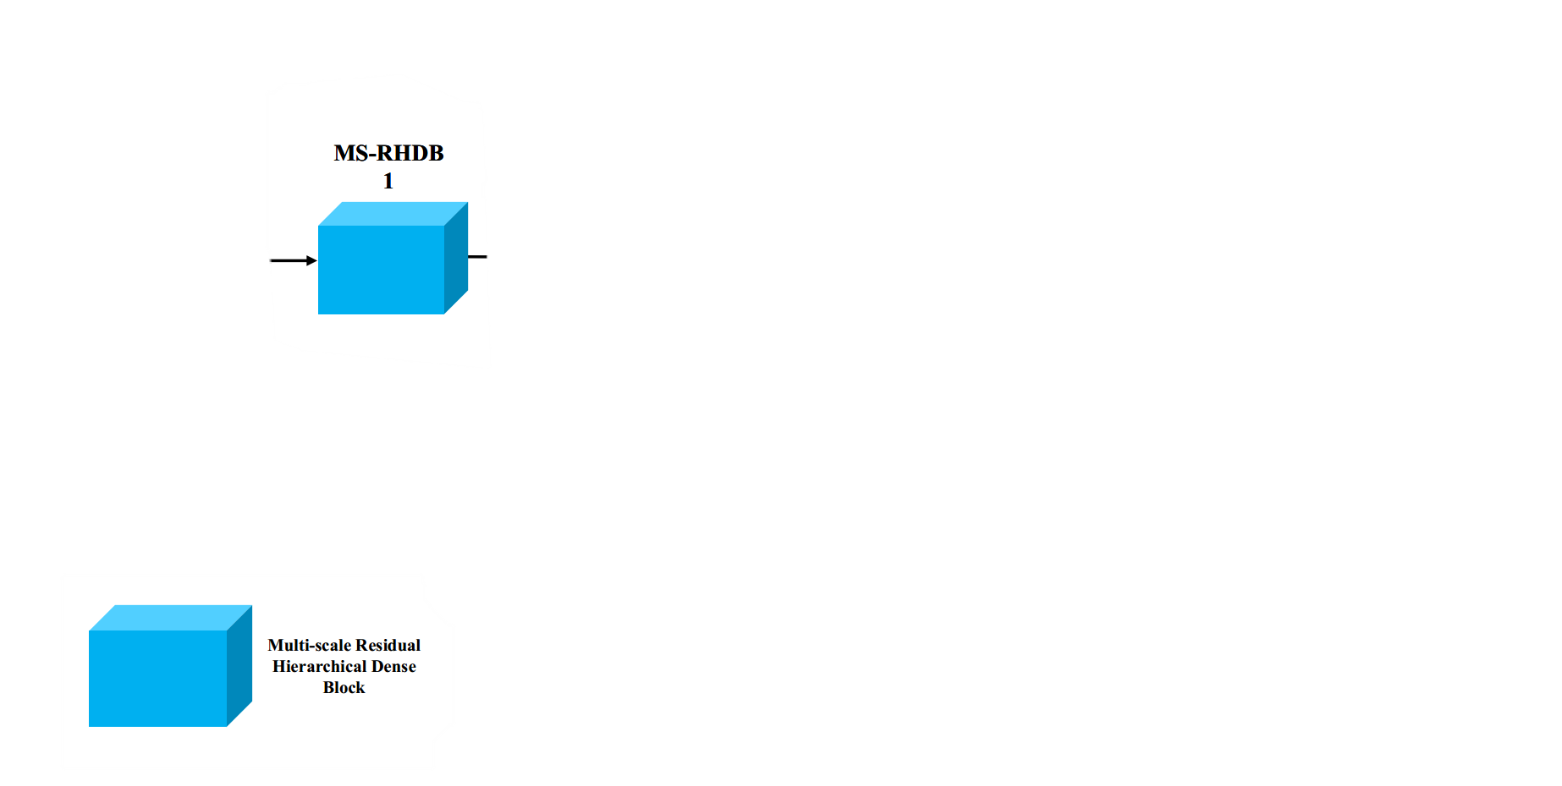
Multi-scale residual hierarchical dense block
(MS-RHDB)
Notes:
Next, I will introduce the main component of our network: MS-RHDB structure, in detail.

Slide 7
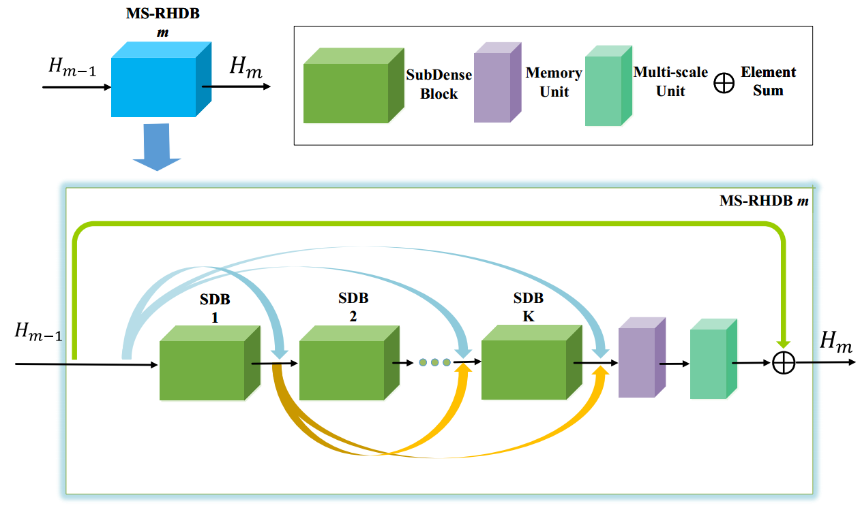
Multi-scale residual hierarchical dense block
Notes:
In the MS-RHDB framework, there exists three parts: a hierarchical dense module, a memory unit, and a multi-scale block.
The hierarchical dense module is built to adequately exploit multi-level features. In this module, we stacked K sub-dense blocks(SDB) in a dense manner. A HDM takes $H_{m−1}$as input, and outputs an intermediate feature $H_{m}$. The structure of SDB is detailed later.
After extracting multi-level features with a set of SDBs, we use a memory unit to integrate these features, which is supposed to adaptively extract unified information. The memory unit is represented as a 1$×$1 convolutional layer
Finally, we use a multi-scale structure to extract features from different scales for taking full advantage of fused features by the memory unit.
A skip connection is introduced for the similar purpose as the global skip connection.

Slide 8
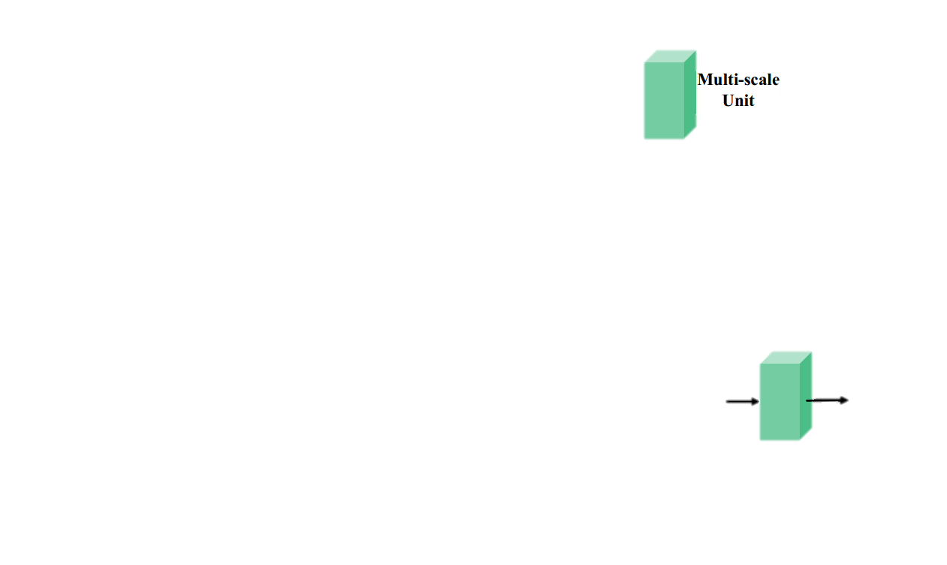

Multi-scale block (MSB)
Notes:
Next, we describe the multi-scale block.

Slide 9
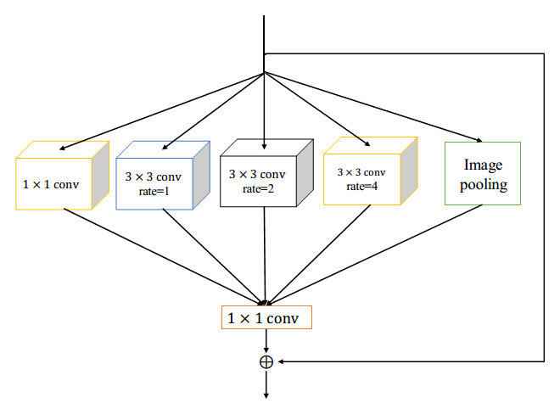
Multi-scale block(MSB)
Motivation:
detect more useful components of the fused DID features
make the network efficient and stable
Notes:
As shown in the figure, a multi-scale block consists of a atrous-spatial-pyramid-pooling (ASPP) structure and a local skip connection.
The ASPP consists of several parallel atrous convolutional layers with different dilated rates. It is used for detecting more useful components of the fused hierarchical dense features.
In addition, to make the network efficient and stable, we add a local skip connection to each ASPP.

Slide 10
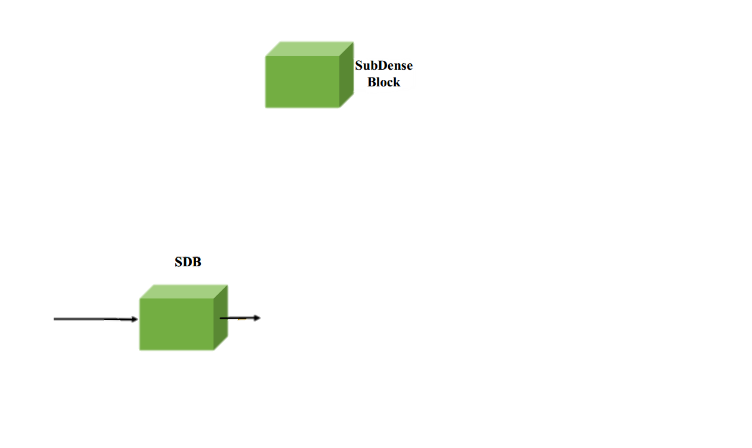
Sub-dense block (SDB)
Notes:
Then, I detail the sub-dense block, which is used to extract local multi-level features from previous concatenated features

Slide 11
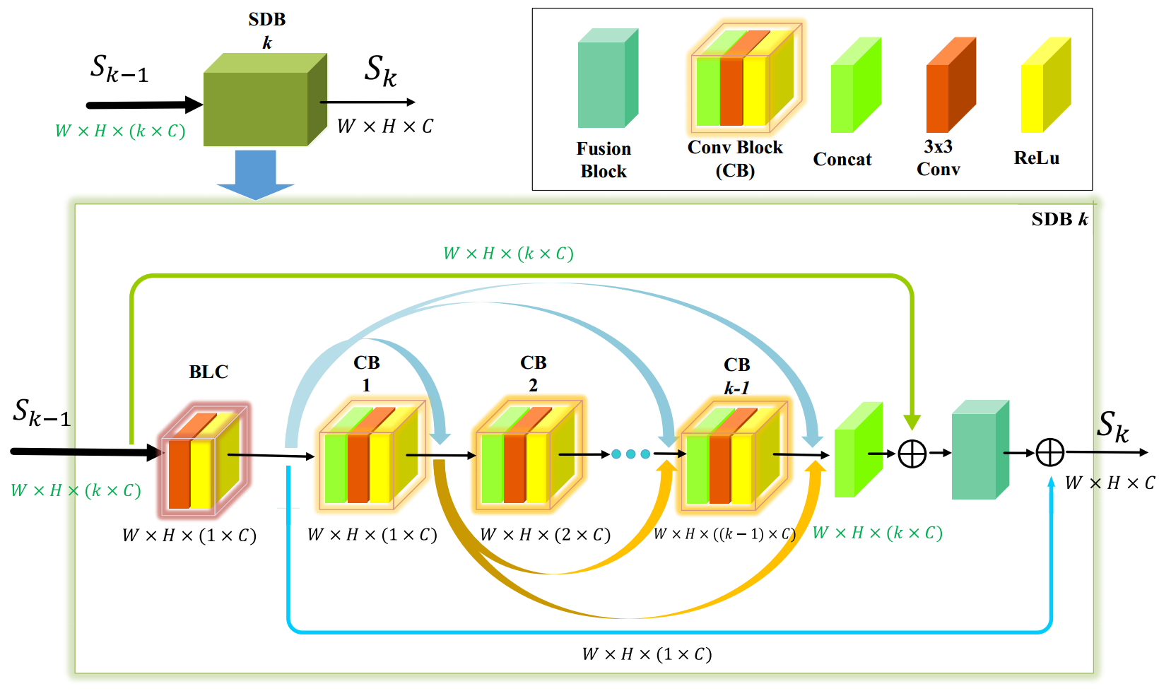
Sub-dense block(SDB)
Notes:
As mentioned above, HDM is constructed by stacking several SDBs in a dense manner. $S_{k−1}$ is the input of SDB, and $S_{k}$ is the output, which contains G feature maps. G is the number of channels and known as growth rate.
SDB contains four components: bottleneck-like compression (BLC), local dense group (LDG), input shortcut connection (ISC), and compression shortcut connection (CSC)
BLC is a bottleneck-like method by a 3$×$3 Conv layer, which is used for reducing parameters and computations. BLC outputs G feature maps.
LDG is used to adaptively detect local multi-level features according to the amount of information that the input has. Because the input channels of each SDB may be different, the convoluntional layers may be different. In other words, the number of convoluntional layers in LDG is adaptively decided by the input channels of the SDB.
The ISC stands for an element-wise addition in the input $S_{k−1}$ and the multi-level features $S_{k−1, k−1}$.Then we apply a 1$×$1 Conv to fuse the number of feature-maps into G.
At last, the compress feature from BLC is added to the output of the fusion block.
ISC and CSC is two important shortcut connection for detecting more informative cues and improving performance, as well as stabilizing the network.

Slide 12
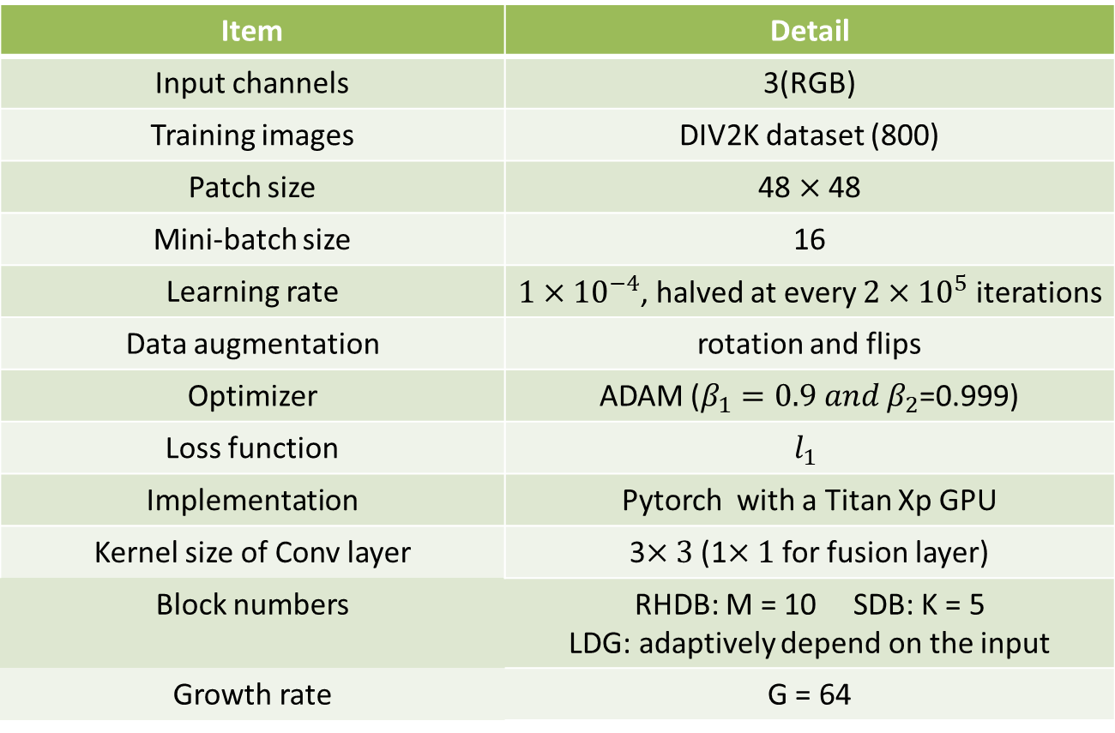
Training details
Item | Detail
Input channels | 3(RGB)
Training images | DIV2K dataset (800)
Patch size | 48 $×$ 48
Mini-batch size | 16
Learning rate | $1×{10}^{−4}$, halved at every $2×{10}^{5}$ iterations
Data augmentation | rotation and flips
Optimizer | ADAM ($β_{1}=0.9 and β_{2}$=0.999)
Loss function | $$l_{1}$$
Implementation | Pytorch with a Titan Xp GPU
Kernel size of Conv layer | 3$×3$(1$×1$ for fusion layer)
Block numbers | RHDB: M = 10 SDB: K = 5 LDG: adaptively depend on the input
Growth rate | G = 64
Notes:
Next, I detail the training of our experiments.
The input channels of the network are 3.
Our training dataset is DIV2K, which contains 800, 100 and 100 images of 2K-resoltion for training, validation, and testing, respectively.
The patch size of the input is 48$×$48, while the batch size is set to 16. The input images are augmented by rotation and flips.
Our model is trained with $l_{1}$ loss function and optimized by the ADAM optimizers, where $β_{1}=0.9 and β_{2}$=0.999. The initial learning rate is $1×{10}^{−4}$, and halves at every $2×{10}^{5}$ iterations.
We set the number of RHDB to M = 10, the number of SDB to K = 5. The number of LDG adaptively depends on the input channels, while the growth rate is set to G = 64.
The model is implemented by Pytorch framework on a Titan Xp GPU.

Slide 13
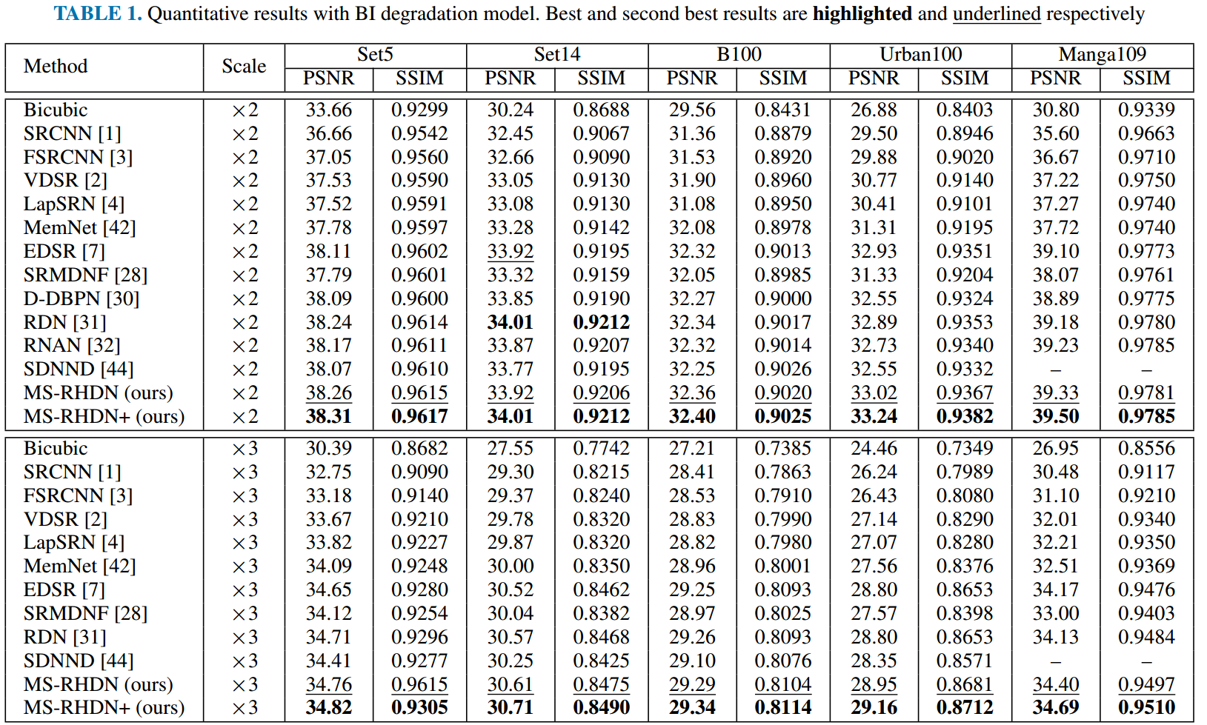
Experimental result(1)
Quantitative comparisons with BI model (A)
Notes:
The table in this slide is the quantitative comparisons between our model and state-of-the-art methods for $×$2 and $×$3 SR on benchmark datasets under the bicubic downsampling (BI) model.
We apply a self-ensemble strategy to our model and donates this version as MS-RHDN+.
As shown in the table, our MS-RHDN+ performs the best on all the test datasets by a large margin. The MS-RHDN also outperforms other compared methods even without self-ensemble.

Slide 14
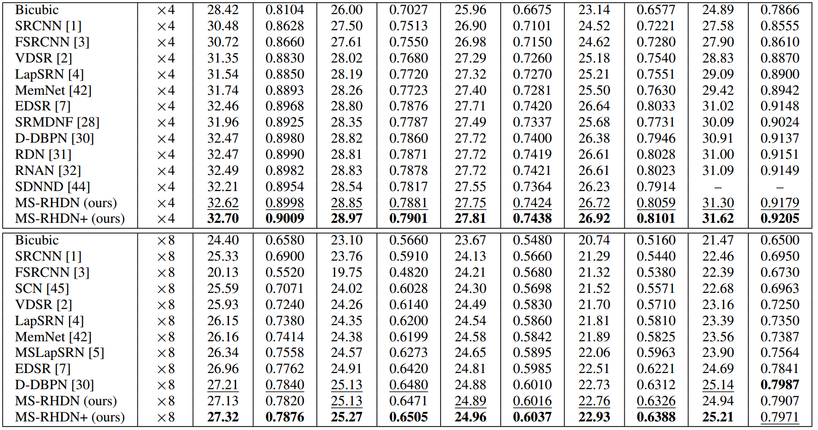
Experimental result(2)
Quantitative comparisons with BI model (B)
Notes:
And this table is for $×$4 and $×$8 SR. Our methods outperform other state-of-the-art methods by large margins as well. And our MS-RHDN obtains larger margins with the increase of scaling factor.
The observations demonstrate that the multi-scale block and residual hierarchical dense structure allow our network to further extract more informative features and improve the performance.

Slide 15
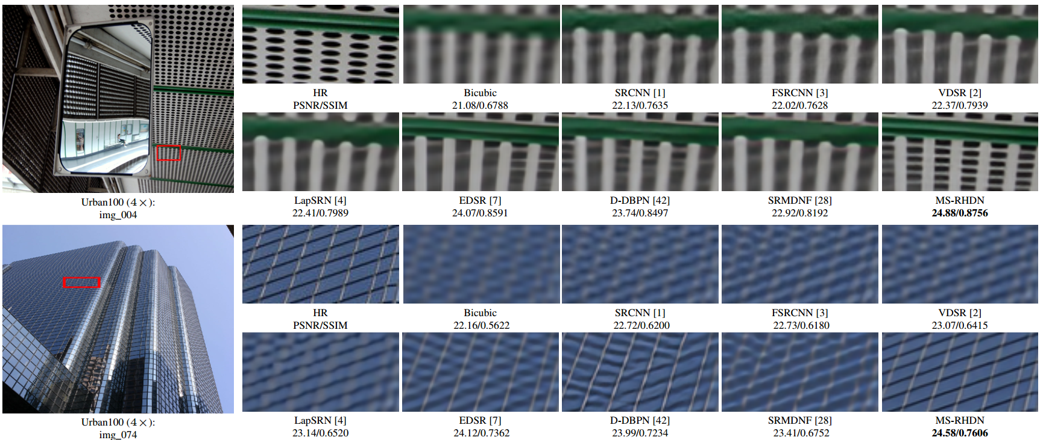
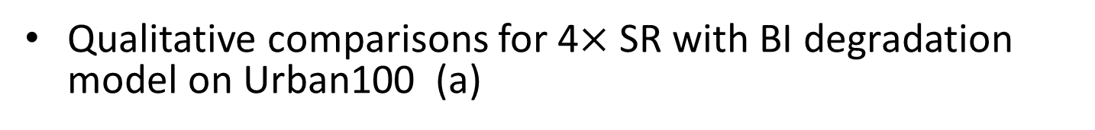
Experimental result(3)
Qualitative comparisons for 4$×$ SR with BI degradation model on Urban100 (a)
Notes:
The slide is the visual comparisons for for 4$×$ SR with BI degradation model on Urban100.
For image ‘img_004’, most compared methods produce images with blurring artifacts and cannot recover the detailed textures of the blue horizontal line and lattices. However, our method can generate more tiny textures and remove the artifacts
For image‘img_074’, most compared methods cannot generate the horizontal line correctly and also suffer from blurring artifacts. Some of them even produce edges with wrong directions. By contrast, our MS-RHDN shows great abilities in producing accurate information from the LR image.

Slide 16
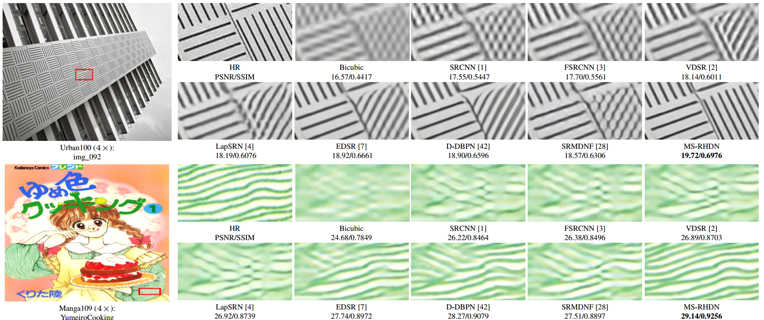
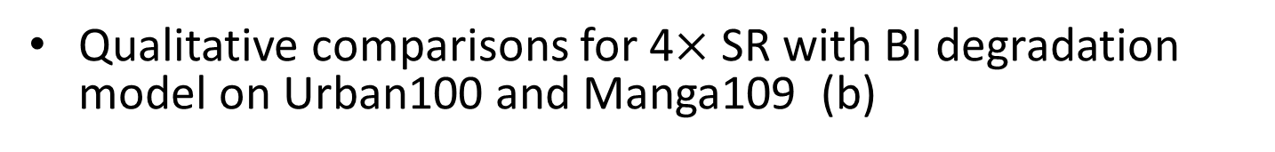
Experimental result(4)
Qualitative comparisons for 4$×$ SR with BI degradation model on Urban100 and Manga109 (b)
Notes:
And for image ‘img_092’, we observe that Bicubic, SRCNN, FSRCNN, VDSR, and LapSRN suffer from blurring artifacts. Even though EDSR, D-DBPN, and SRMDNF can recover some high-frequency information, the right part of the cropped image generated by these methods shows wrong directions of the gap with over-smoothed edges. Our MSRHDN can be more faithful to the ground truth.
For image‘YumeiroCooking’in the Mange109, due to the abundance of textures, most compared methods cannot fully recover them and obviously produce blurring artifacts. Our method achieves a better result, which is more similar to the HR image

Slide 17
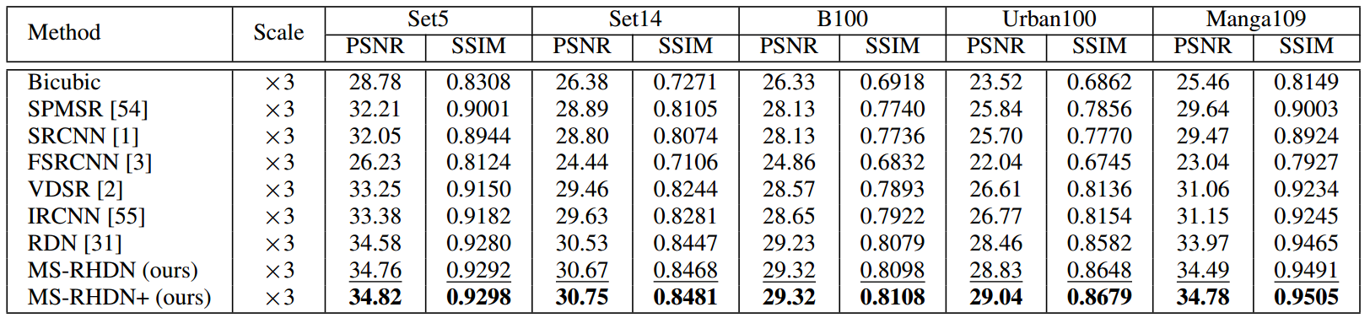
Experimental result(5)
Quantitative comparisons with BD degradation
Notes:
The table is about the quantitative comparisons for 3$×$ SR on benchmark datasets with blur down degradation model.
We observe that our MS-RHDN has much better performance on all the benchmark datasets, and MS-RHDN+ achieves the best results. Our methods outperform RDN by a large margin.
These observations indicate that the structure MS-RHDN is more efficient and has a stronger ability to recover images from the blur-down degradation model.

Slide 18
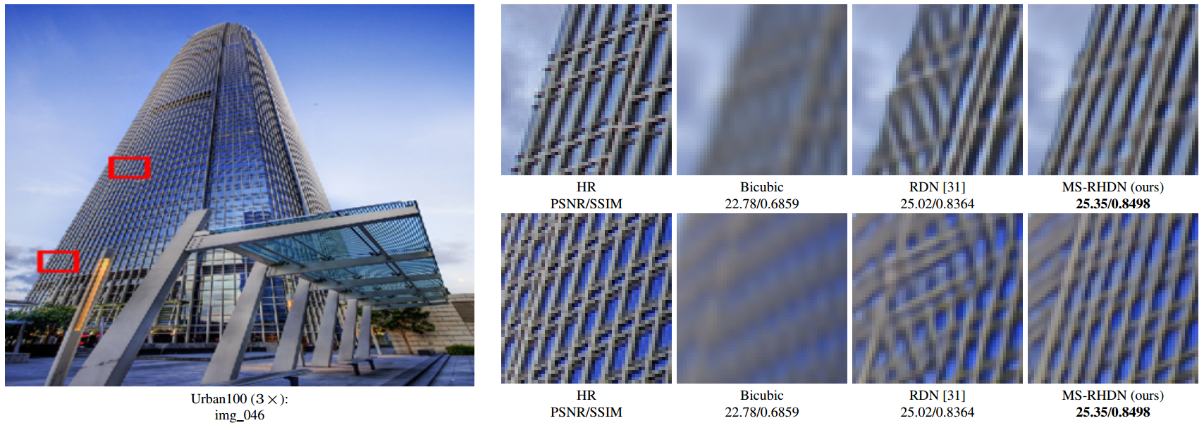
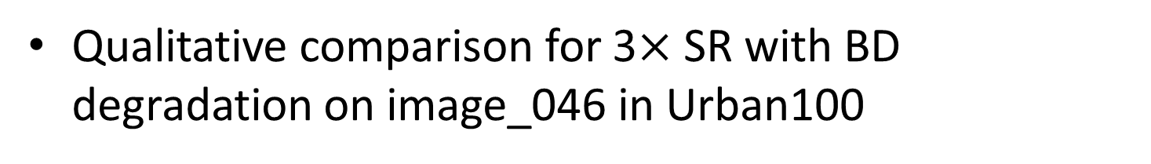
Experimental result(6)
Qualitative comparison for 3$×$ SR with BD degradation on image_046 in Urban100
Notes:
This slide is the visual comparison for 3$×$ SR with BD degradation model on img_046 in Urban100.
The two patches generated by bicubic are totally blurred and lose most details. RDN can recover some details but produces some edges with wrong directions. In contrast, MS-RHDN obtains much better performance with sharper edges and correct structures.

Slide 19
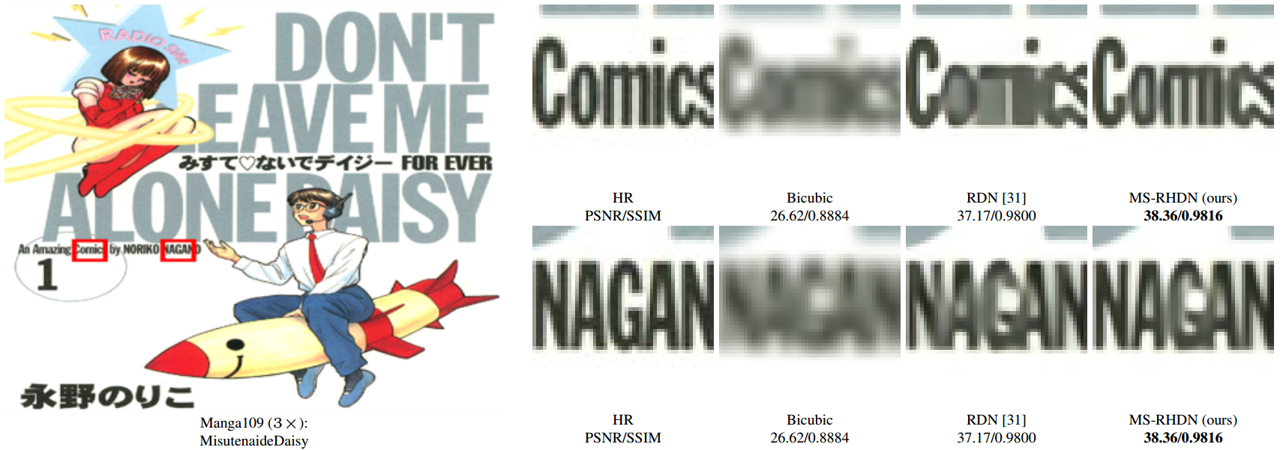
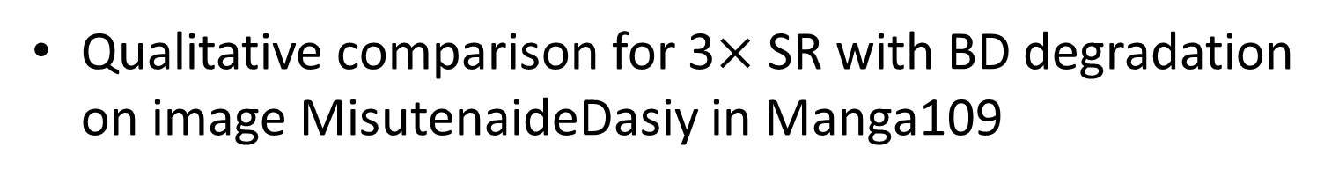
Experimental result(7)
Qualitative comparison for 3$×$ SR with BD degradation on image MisutenaideDasiy in Manga109
Notes:
For image ‘MisutenaideDaisy’ in Manga109, characters in the two patches produced by bicubic cannot even be recognized by eyeballing. RDN recovers some details of the characters with simple structures, e.g., “c” and “s”. However, some characters in the first patch suffer from blurring artifacts and lose some structures. In comparison, MS-RHDN can recover more details and maintain the right structures. In the second patch, RDN generates characters with over-smoothed edges and blurring artifacts. In contrast, our MS-RHDN alleviates the over-smoothness and blurring-artifacts issues by recovering sharper edges

Slide 20
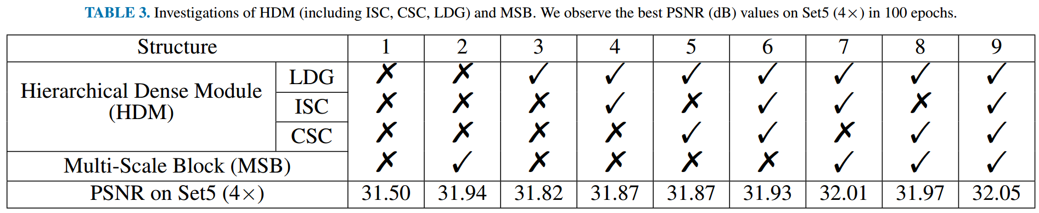
Network investigation(1)
Ablation investigations on the effects of the local dense group (LDG), input shortcut connection (ISC), compression shortcut connection (CSC) and multi-scale block(MSB)
Notes:
We also conduct ablation investigations on the effects of local dense group (LDG), input shortcut connection (ISC), compression shortcut connection (CSC) and multi-scale block(MSB).
This slide is the investigation on LDG. The performance improvement from structure 1 and 3 demonstrated the positive effect of LDG.

Slide 21
Network investigation(2)
Ablation investigations on the effects of the local dense group (LDG), input shortcut connection (ISC), compression shortcut connection (CSC) and multi-scale block(MSB)
1
1
2
2
3
3
Notes:
The performance improvements from structure 3 to 4, or 5 to 6, or 8 to 9 indicate the efficiency of ISC.

Slide 22
Network investigation(3)
Ablation investigations on the effects of the local dense group (LDG), input shortcut connection (ISC), compression shortcut connection (CSC) and multi-scale block(MSB)
1
2
1
2
3
3
Notes:
The performance improvements from structure 3 to 5, or 4 to 6, or 7 to 9 indicate the efficiency of CSC.
Thus it can be seen that the ISC and CSC are significant for producing high-quality images.

Slide 23
Network investigation(4)
Ablation investigations on the effects of the local dense group (LDG), input shortcut connection (ISC), compression shortcut connection (CSC) and multi-scale block(MSB)
Notes:
It can be seen that compared structure 1 and 6, after adding HDMs, the performance increases to 31.93 dB from 31.50 dB.

Slide 24
Network investigation(5)
Ablation investigations on the effects of the local dense group (LDG), input shortcut connection (ISC), compression shortcut connection (CSC) and multi-scale block(MSB)
1
1
2
3
2
3
Notes:
When MSBs are added, the PSNR value increases from 31.93 dB in structure 6 to 32.05 dB in structure 9. Comparisons between structure 1 and 2 or structure 4 and 7 demonstrate the effectiveness of the MSB as well.

Slide 25
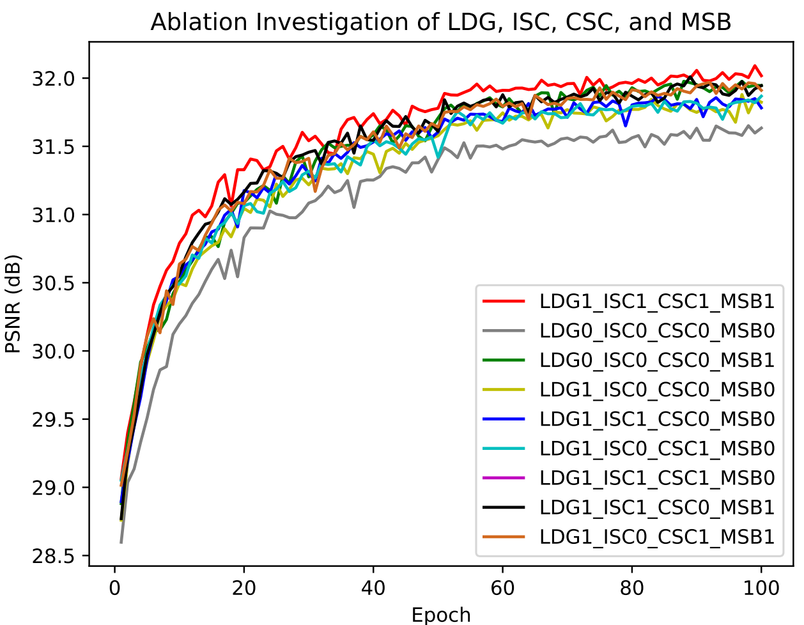
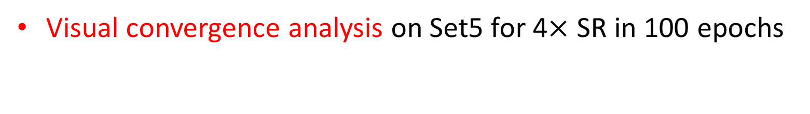
Network investigation(6)
Visual convergence analysis on Set5 for 4$×$ SR in 100 epochs
Notes:
This figure is the visual convergence analysis on LDG, ISC, CSC, and MSB, based on the PSNR on Set5 for 4$×$ in each epochs.
The curves is consistent with our analyses, and the LDG, ISC, CSC, and MSB can further improve the performance.
The above quantitative and visual analyses show the superiority of our LDG, ISC, CSC of the HDM and MSB.

Slide 26
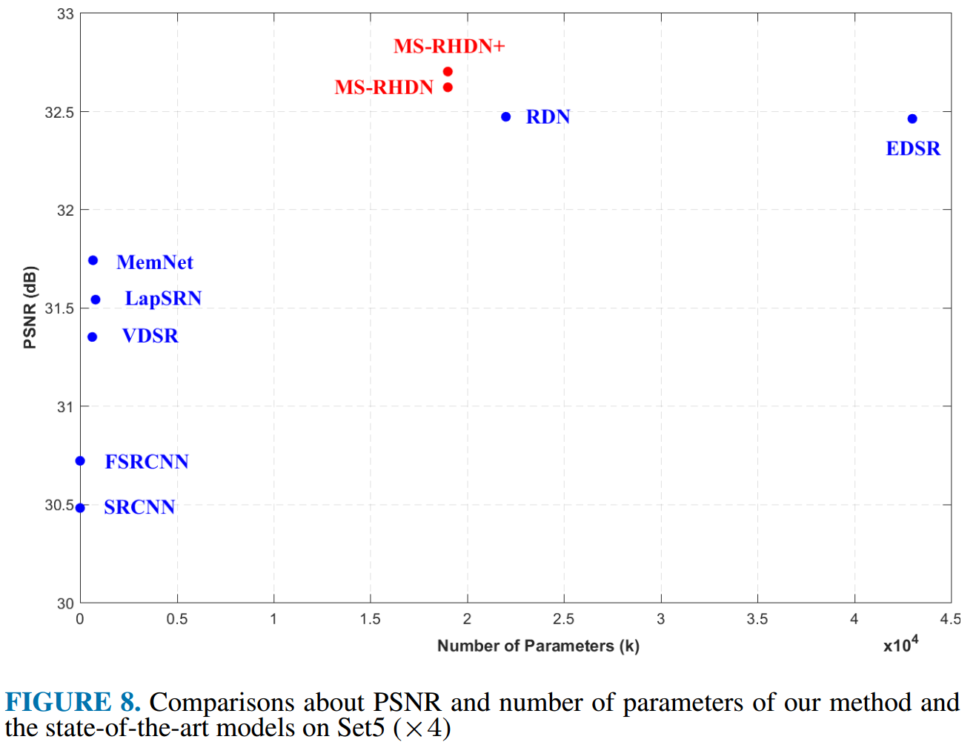
Parameters VS. PSNR
Notes:
This figure shows comparisons of PSNR versus the number of parameters of our method and the compared methods.
We can observe that our MS-RHDN and MS-RHDN+ have only half parameters of EDSR and also fewer parameters than RDN, achieving better performance. It demonstrates that our model has a more effective structure and a better trade-off between performance and model size.

Slide 27
Thank you!

